Slide 1

The Pink Avengers
By: Pedro Gomez, Lakshmi Bhimavarapu, Anna De Jesus, Devin Sherwood and Antara Choudhury

Slide 2

OBJECTIVE
Every year during October, Breast Cancer Awareness campaigns are put together to increase the awareness of the disease. Many forget to take the necessary steps to have a plan to detect the disease in its early stages. We plan to use the information gathered in this study to automatically detect if a breast tumor is malignant or benign. We will use machine learning to help with early diagnosis of breast cancer by analyzing the characteristics found in the digitized images of hundreds of tumors to determine whether they are malignant or benign.

Slide 3
Dataset to Use and Research Questions to Answer
https://www.kaggle.com/code/pierrelouisdanieau/breast-cancer-prediciton-ml-dl/data
1. Could we detect if a breast tumor is malignant or benign?
2. Which characteristics are most relevant?
3. Which were the best parameters used during optimization?

Slide 4
Preparing Data and Loading to Database
Preparing Data
Data cleaned in Jupyter Notebook by checking for null or missing variables, and dropping last ‘unknown’ column and redundant ‘id’ column
Data was normalized and standardized using scikit-learn
Loading to Database (PostgreSQL)
Data was loaded to PostgreSQL using SQL Alchemy

Slide 5
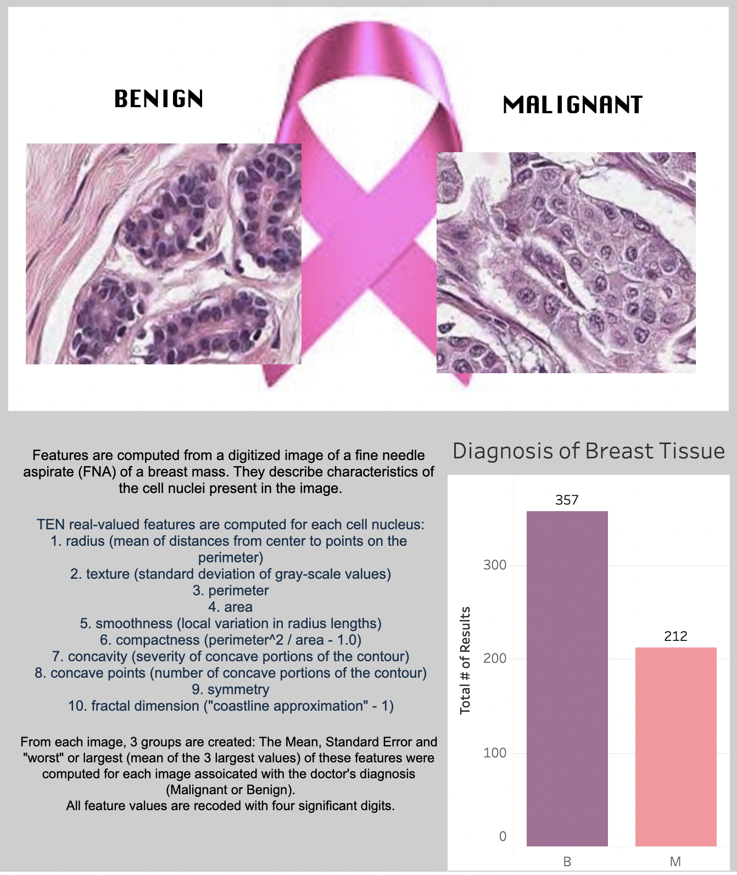

Slide 6
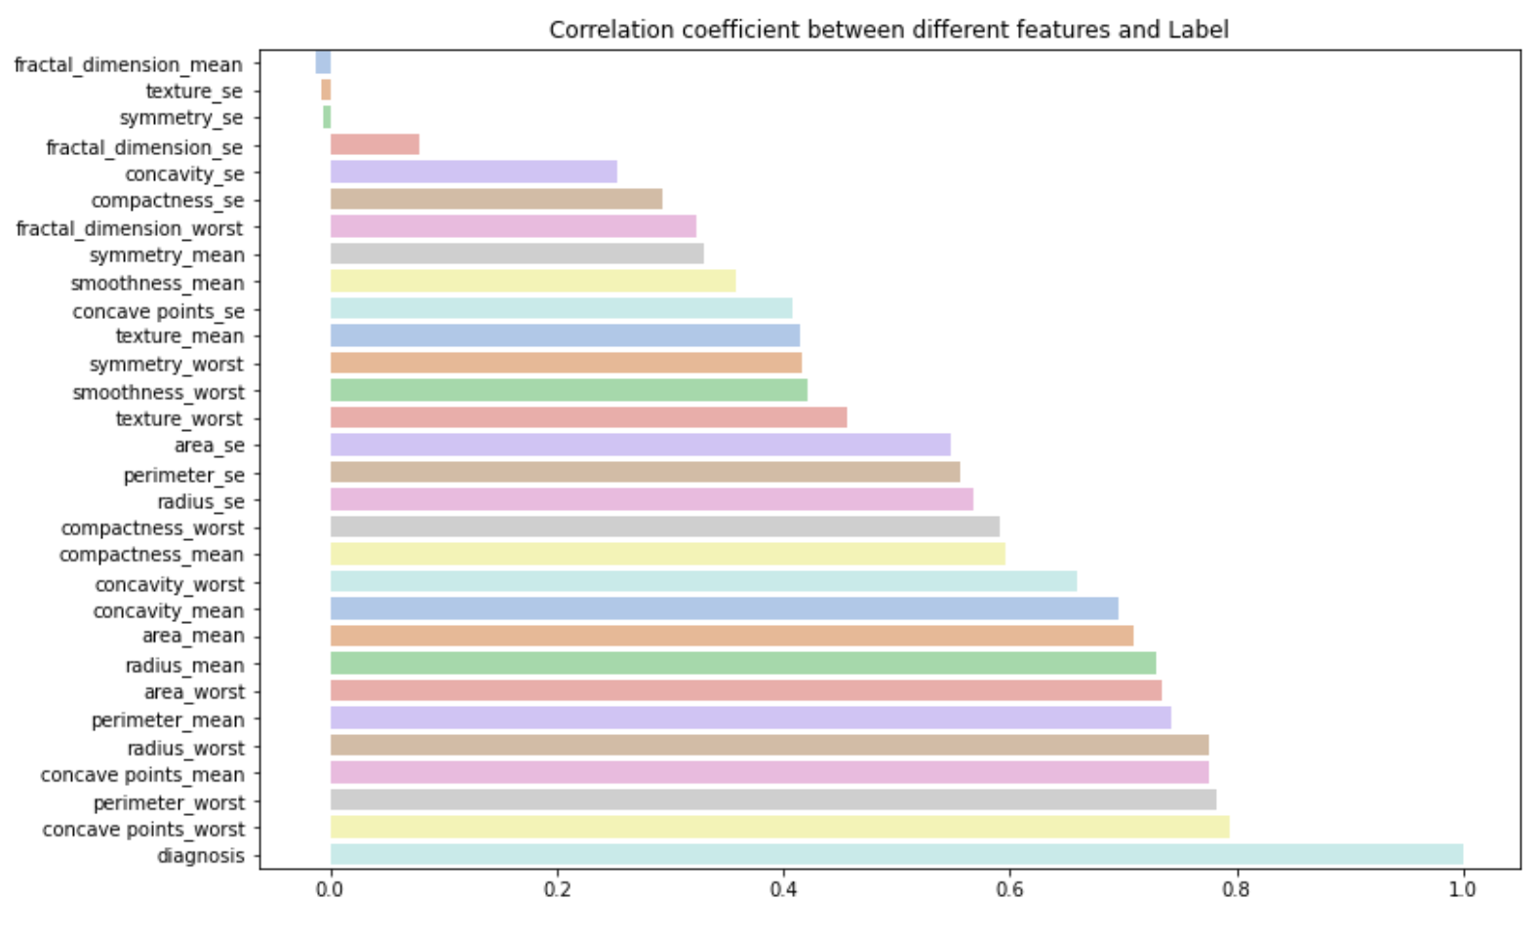
Matplotlib
Based on the methods developed in this process from digitized images and a whole set of characteristics describing each of the cells of the tumor,
3 groups are created : Mean, Standard Error and Worst values of 10 characteristics each associated with the doctors' diagnosis (Malignant or Benign).
These 10 features represent geometric characteristics of the cells. Here we see that most of the variables are positively correlated with respect to the variable to be predicted.

Slide 7
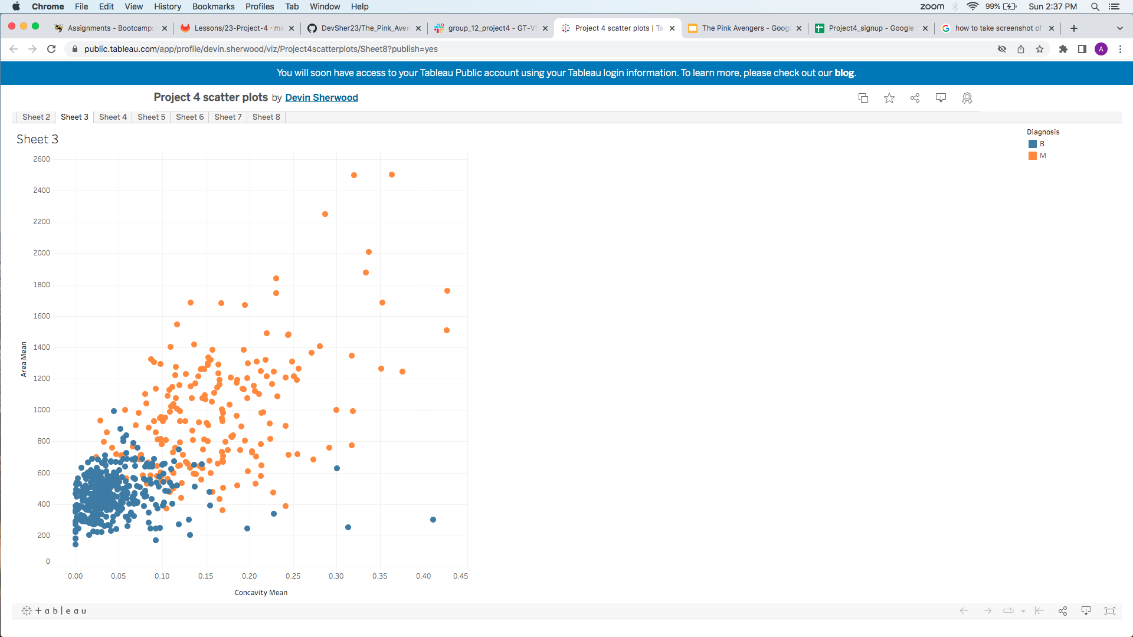
Tableau
"Area mean": Area Mean represents the average size of the breast mass sample. Larger masses may be more likely to be malignant.
"Concavity mean": This variable represents the mean severity of concave portions of the contour or “spikiness” of the breast mass sample. Higher values of concavity mean could indicate more severe irregularities which could be indicative of malignancy.

Slide 8
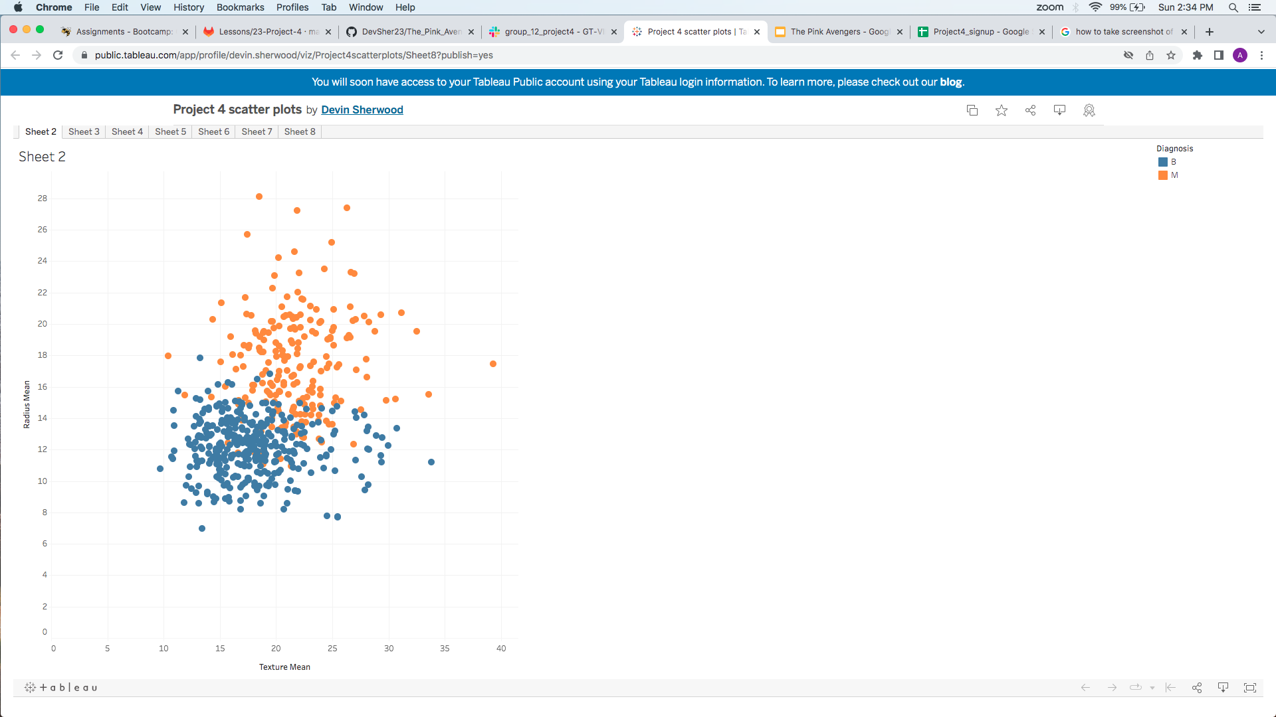
Tableau
“Radius mean”: This variable refers to the average size of the tumor.
“Texture mean”: This variable refers to the uniformity of the cells in the sample.
Higher radius and texture mean could indicate a higher likelihood of a malignant tumor, while a lower radius mean and texture mean could indicate a benign tumor.

Slide 9
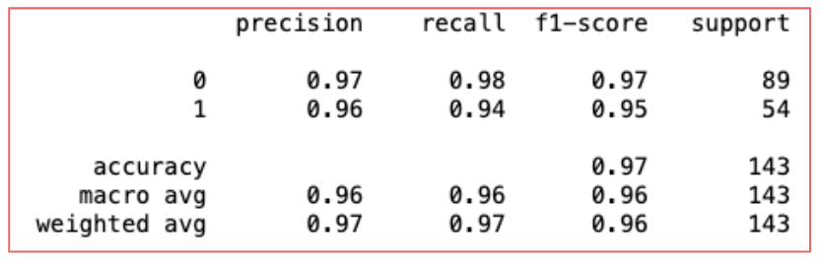
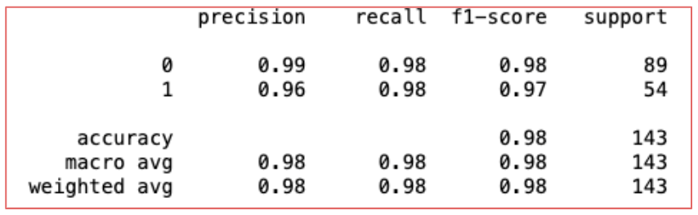
Data Model Machine Learning
Python script to evaluate two models:
Random forest optimizing with RandomizedSearchCV
Logistic regression optimizing with GridSearchCV

Slide 10
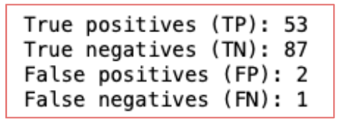
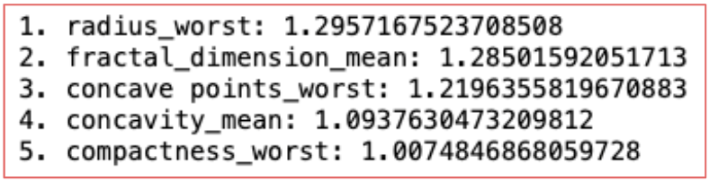
Data Optimization Machine Learning
Our optimization was aimed to reduce false negatives. Below the confusion matrix for the logistic regression
Top 5 parameters with most significant impact in determining a malignant tumor

Slide 11
Conclusion
After using machine learning to help with early diagnosis of breast cancer we concluded that:
1. Yes, we can detect if a breast tumor is malignant or benign. Overall, the variables we used in our testing is very helpful in the aid of identifying potential biomarkers/predictors for breast cancer.
2. Which characteristics are most relevant?
Size, shape, texture
3. Which were the best parameters used during optimization?
Radius_worst, fractal_dimension_mean, concave points_worst, concavity_mean and compactness_worst

